Slide 1
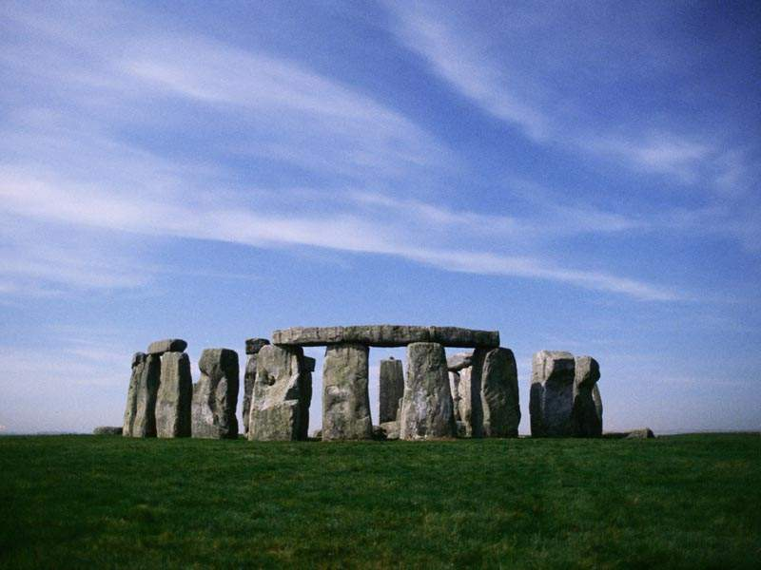
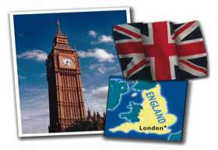
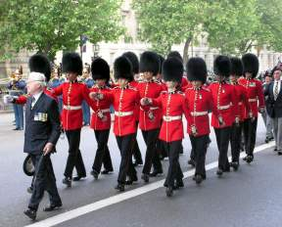

Slide 4
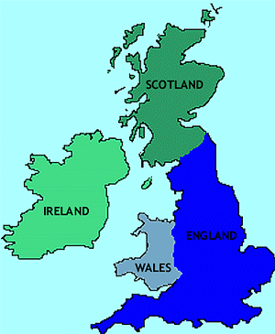
Great Britain consist of four parts:

Slide 5
The queen of great Britain

Slide 6
Elisabeth II

Slide 7
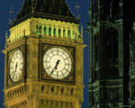
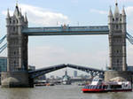
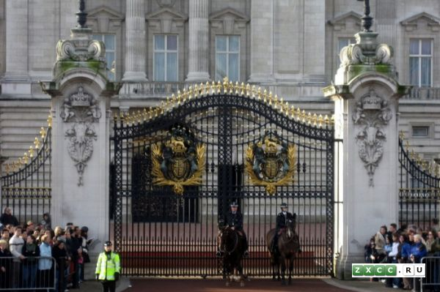
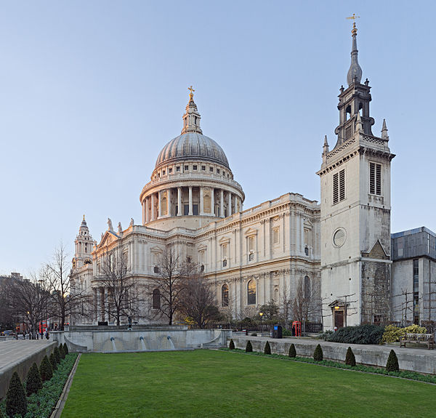
The places of interest in London

Slide 8
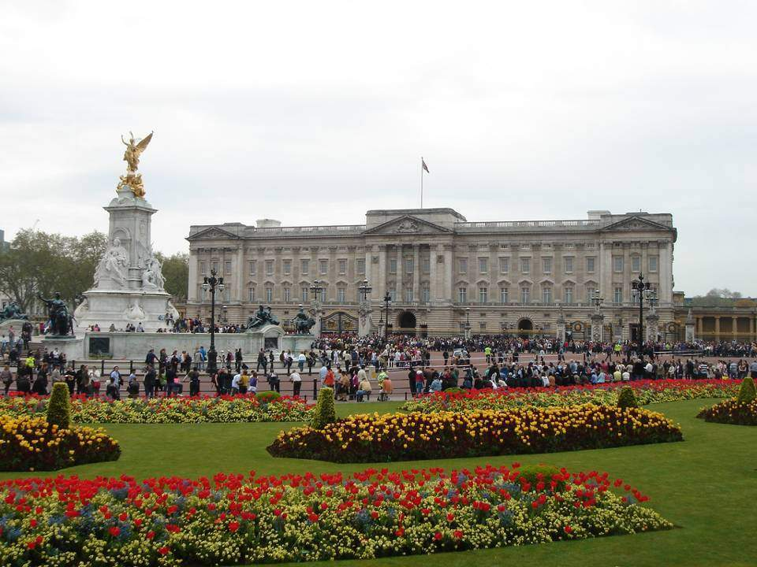
Buckingham Palace

Slide 9
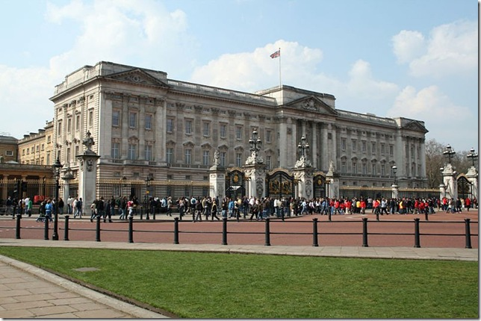

Slide 10
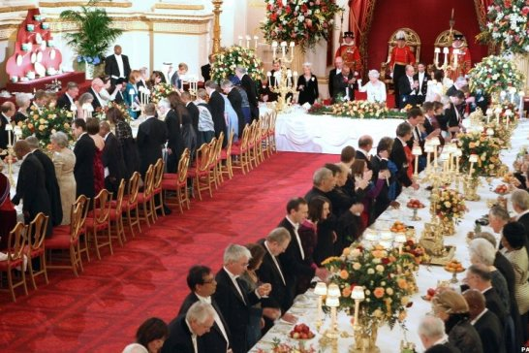

Slide 11
Westminster Abbey

Slide 12
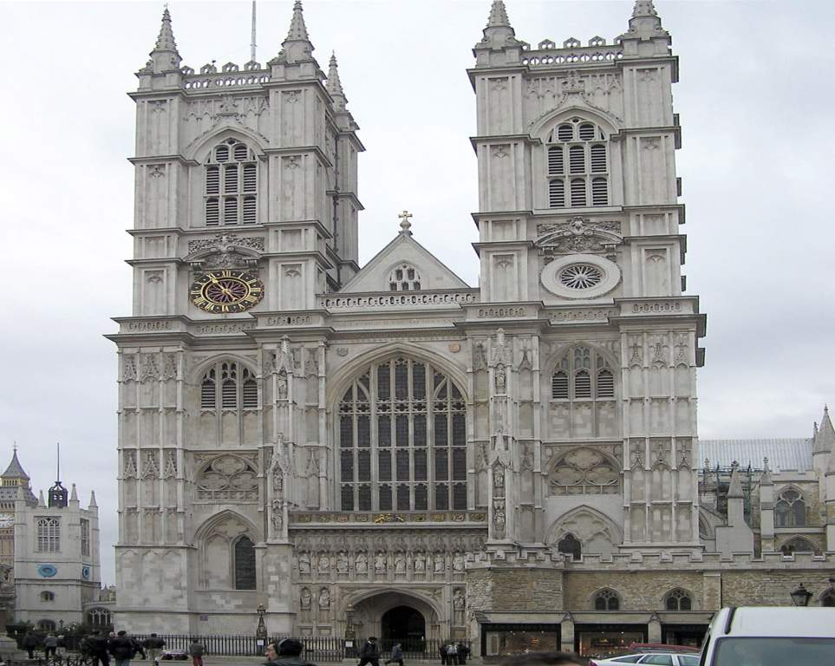
Westminster Abbey

Slide 13
Trafalgar Square

Slide 14
the Nelson column

Slide 15
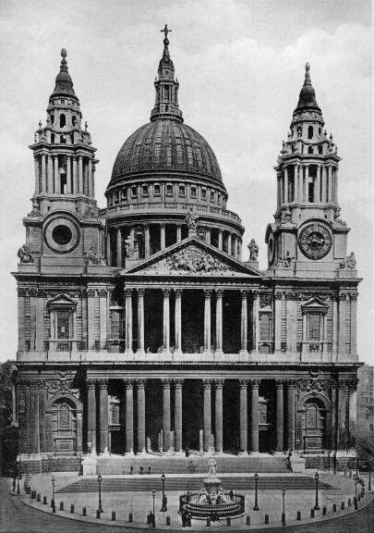
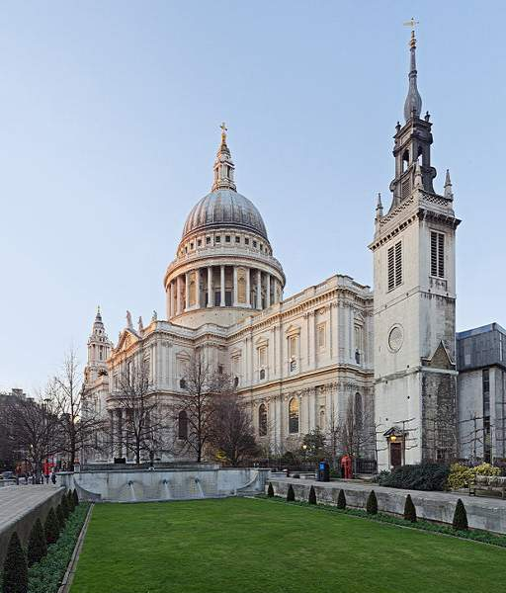
St. Paul's Cathedral

Slide 16
Big Ben

Slide 17
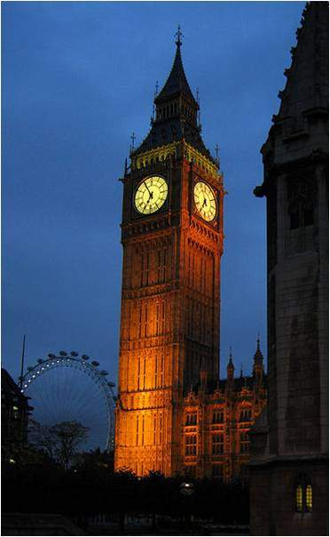
Big Ben

Slide 18
THE TOWER OF LONDON

Slide 19
TOWER BRIDGE

Slide 20
Stonehenge

Slide 21
Regent’s Park

Slide 22
Piccadilly Circus

Slide 23
The main river in Britain is Thames

Slide 24
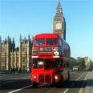
The main buses are double – dеckers

Slide 25
Favorite food and drink
Fish and chips
Tea with milk

Slide 26
Answer the question
The capital of Great Britain is…
Who is the head of Great Britain?
How many part consist the Britain?
Name British interesting places you now.
Which river is main in Britain?
How British people called their buses?

Slide 27
THANK YOU FOR YOUR WORK!

