Slide 1
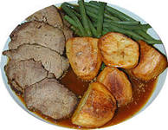
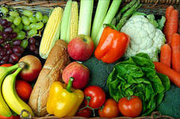
FOOD & MEALS

Slide 2
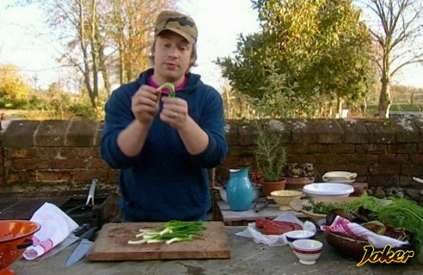
Do you remember our friend Jamie Oliver?

Slide 3
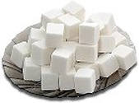
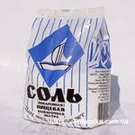
From: Jamie To: 7th Grade students
Add some to make your tea sweet.
2) Add some to make your roast beef spicy.
3) This soup is disgusting, there is too much .
4) Tea and is a nice combination for lunch.
5) Some will be a nice company for your pudding.

Slide 4
Watch a short movie, fill in the table and be ready to answer the questions.
BREAKFAST | ???
LUNCH | ???
DINNER | ???

Slide 5
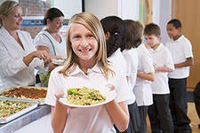
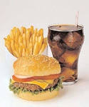
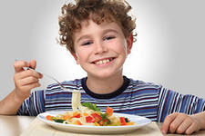
Answer the questions:
What is ‘convenience food’?
What food do the British teenagers prefer?
What’s your favourite food?

Slide 6
Read and fill in:
add, boil, cut, get, mash, peel, put, take, wash, add
1)____3 or 4 potatoes. 2)____them. 3) Then ____ them carefully. 4)If the potatoes are very big , ____ them into smaller pieces. 5)Then ____ them into cold water, ____ some salt and ____ till they are ready. 6)____ the water out and ____some milk and butter. 7)Wait till the milk starts boiling. _____ everything carefully.

Slide 7
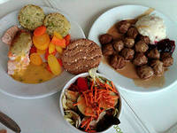
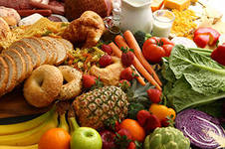
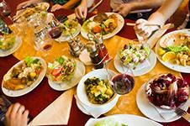
What new information have you learned today?

Slide 8
THANK YOU FOR YOUR WORK!

